Slide 1
data
I
G
B
By Daniel addo

Slide 2
End-result of the microservice system
Design SERVICE
Register SERVICE
Print SERVICE
FRONTEND

Slide 3
Services implemented
Register SERVICE
This service allows crownpass holders to register , log-in , logout.
DISPLAY SERVICE
This service allows users to visual display the Crownpass
PRINT SERVICE
This service allows the user to print out the Crownpass.
FRONTEND
This service utilises all the service listed above.

Slide 4
OVERALL BENEFITS
Microservice architecture
Individual domain
Not tightly coupled and easy to understand

Slide 5
data
I
G
design of graphic user interface
B

Slide 6

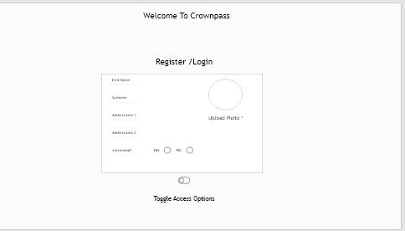
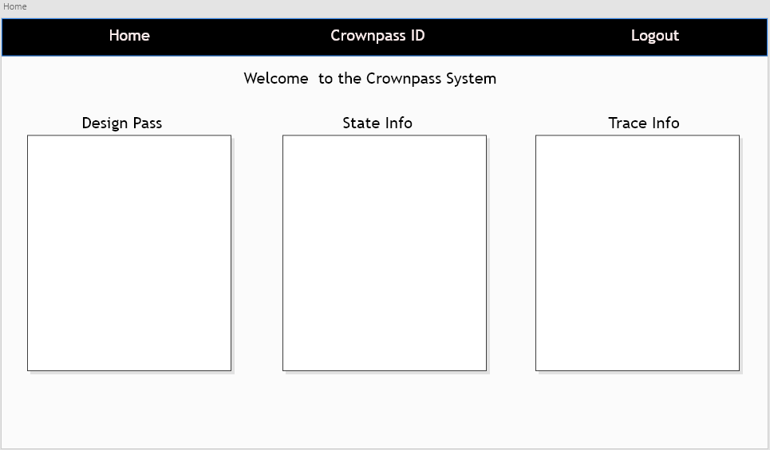
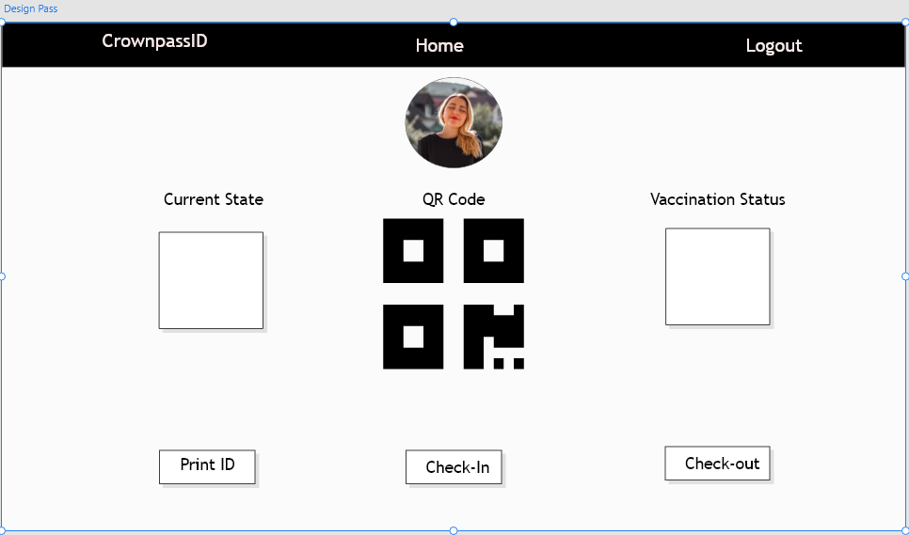
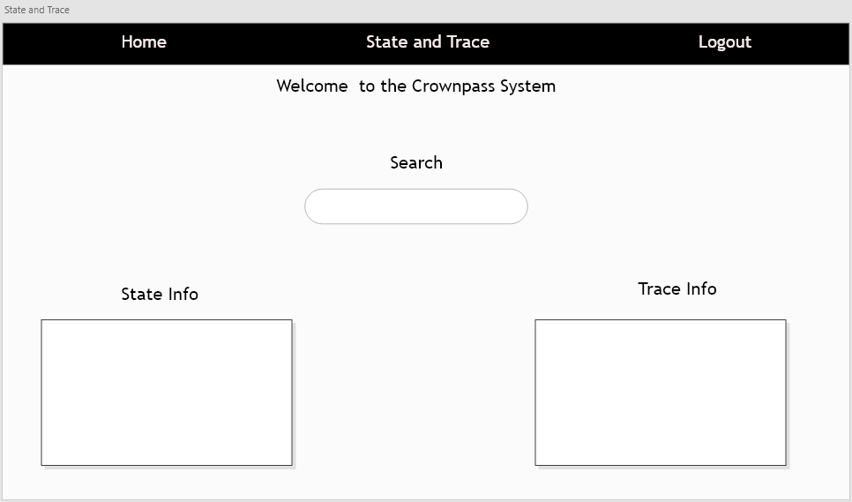
Intended system design
1
2
3
4
Register page
Home page
Design pass
STATE & trace

Slide 7
data
I
G
design of API ENDPOINTS
B

Slide 8
register SERVICE – api endpoints
POST request -
/create_user
POST request -
/login
POST request -
/logout
GET request -
/user/<username>/exists (debugging purposes)
GET request -
/<username>/active
GET request -
/user
GET request -
‘ get/users’ (debugging purposes)
DELETE request -
/remove_user
DELETE request -
user/remove_all (debugging purposes)

Slide 9
Design pass SERVICE – api endpoints
GET request -
/ get_qr_code
DELETE request -
/delete_qr_code
PUT request -
/update_qr_code
POST request -
/create_qr_code

Slide 10
Print SERVICE – api endpoints
POST request
/print

Slide 11
Frontend SERVICE – API ENDPOINTS
“index”
“login”
“home_page”
“logout”
“display_qr”
“upload_image”
“register”
“print_qr”

Slide 12
Linked API ENDPOINTS
PRINT service
Register service
CHECK_QR_TO_PRINT()
GET_HOLDER()
DISPLAY service

Slide 13
data
I
Reliability
Scalability
G
performance
ADDRESSING REQUIREMENTS
B

Slide 14
data
I
G
Implementation Stage
B

Slide 15
data
I
G
Testing Stage
B

Slide 16
data
I
G
INTEGRATION Stage
B

